Slide 1
Data Analysis – Team project Crime rate in west midlands
Team 4
Jyothi Palle
Olive Mckenzie
Hoi Hei Ng (Tony)

Slide 2
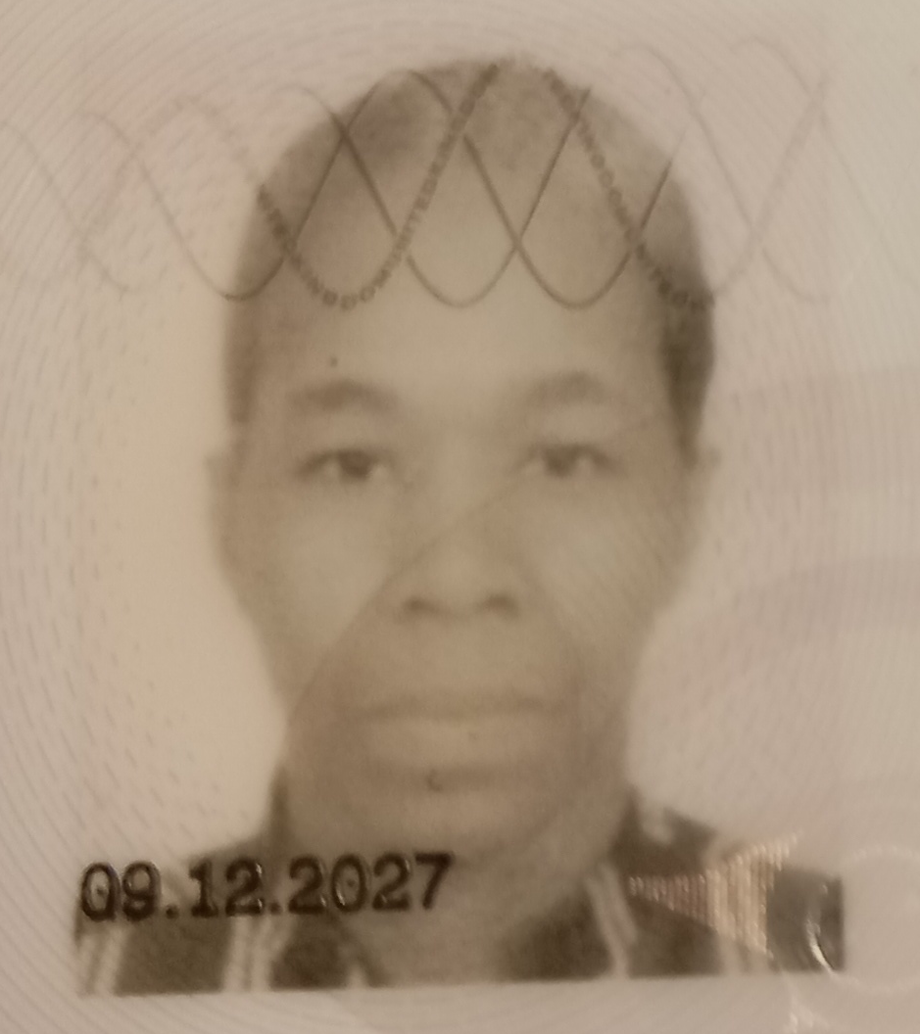


MEET OUR TEAM
Olive McKenzie
Jyothi Palle
Hoi Hei Ng (Tony)

Slide 3
Agenda
Introduction
Dataset selection
Setup Questions
Conclusion
How do we get results

Slide 4
INTRODUCTION
According to Region Security Guarding Report, West Midlands ranked 4th highest crime rate in UK with an estimated population of 2.9 million people.
With over 250,000 crimes being reported a year, a reported crime rate of 110.6 crimes per 1000 people with violence and sexual offences being the highest reported crime
Present with graphs and plots to give a more in-depth picture of crimes happened in West Midlands
Recommendations to lower the crime rate
https://data.police.uk/
https://www.regionsecurityguarding.co.uk/blog/crime/top-10-most-dangerous-areas-in-england-and-wales/

Slide 5
Data selection

Slide 6
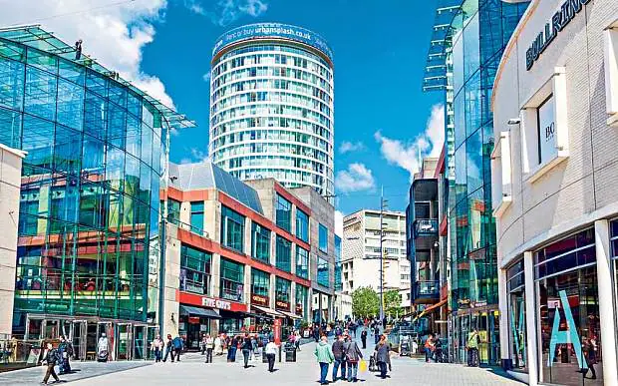

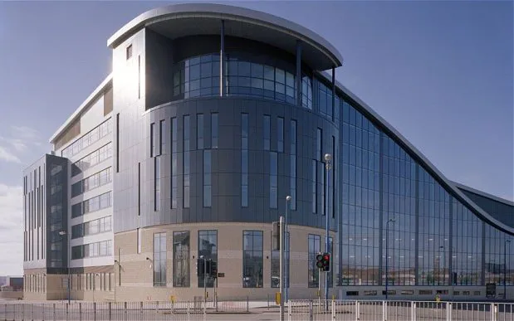
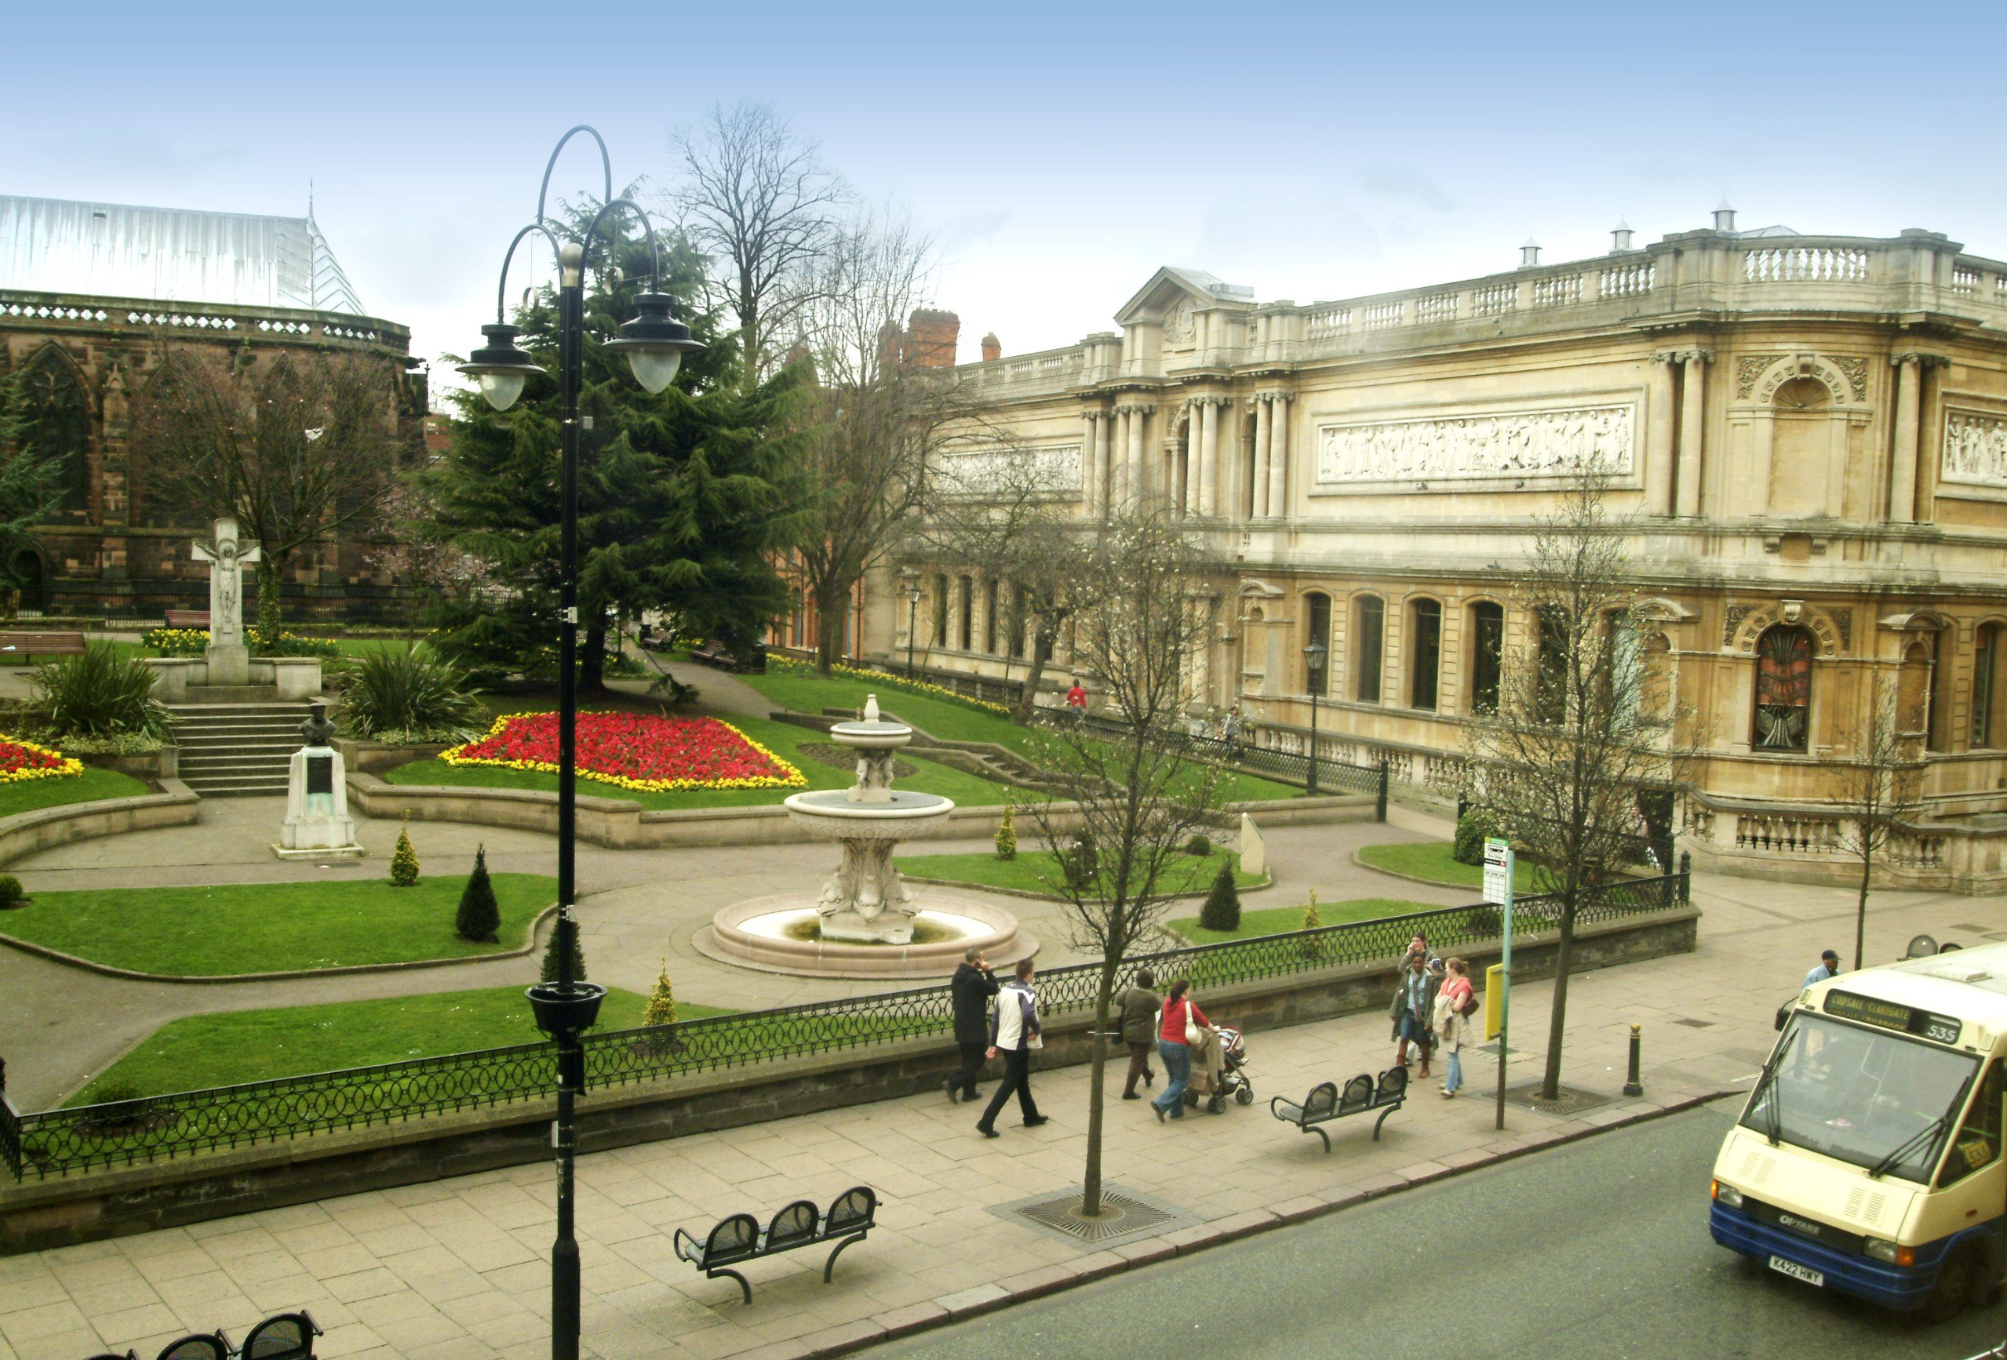
We have chosen 4 cities in the West Midlands with the highest rates of crime
BIRMINGHAM
COVENTRY
SANDWELL
WOLVERHAMPTON

Slide 7
Questions setup

Slide 8
Q1
Which area has the most crimes? (Olive)
Q2
What kind of crimes occur in each area? /
Which crime has the most records in each area? (Olive)
Q3
How are the crime cases distributed in the 4 areas?
Does the population affect the crime rate? (Tony)
Q4
What is the crime rate trend throughout 2022 (Tony)
Q5
What are Crime outcome status? (Jyothi)
Q6
What are the closed categories? ( Jyothi)

Slide 9
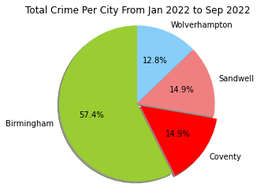
Question 1
Overall Crimes in Birmingham, Coventry, Sandwell and Wolverhampton for the nine months January 2022 – September 2022
Ranking cities according to highest crime rate: (1)Birmingham, (2)Coventry, (2)Sandwell, (3)Wolverhampton

Slide 10
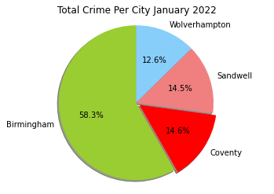




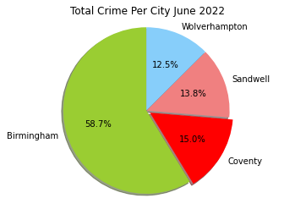



Total Number of crimes per city from Jan 2022-Sep 2022
Total Number of crimes per city over the nine months remained almost constant
with very small fluctuations. 1.6 for Birmingham, 2.4 for Wolverhampton,1.1 Coventry and 1.5 for Sandwell

Slide 11
WHAT KIND OF CRIMES OCCUR IN EACH AREA?
These are all the Kinds of Crimes which occur in each area
Violence and sexual offences
Vehicle crime
Public order
Criminal damage and arson
Other theft
Anti-social behaviour
Burglary
Shoplifting
Drugs
Robbery
Other crime
Possession of weapons
Theft from the person
Bicycle theft

Slide 12
Question 2
WHICH CRIME HAS THE MOST RECORDS IN EACH AREA?​
City | Crime Type | Number Of Crimes Committed
Birmingham | Violence and sexual offences | 6177
Sandwell | Violence and sexual offences | 1528
Coventry | Violence and sexual offences | 1503
Wolverhampton | Violence and sexual offences | 1417

Slide 13
Total crimes committed in January 2022 for all four Areas
Crimes | Number of Crimes
Violence and sexual offences | 13179
Vehicle crime | 2671
Public order | 2466
Criminal damage and arson | 2221
Other theft | 1875
Anti-social behaviour | 1668
Burglary | 1603
Shoplifting | 1270
Drugs | 640
Robbery | 621
Other crime | 544
Possession of weapons | 504
Theft from the person | 366
Bicycle theft | 169

Slide 14
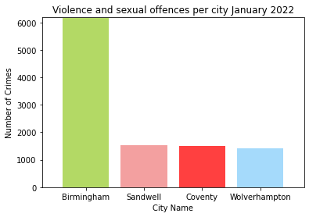
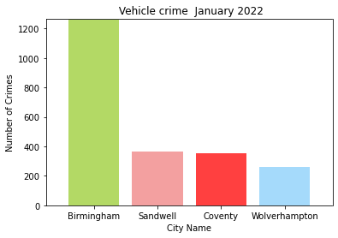
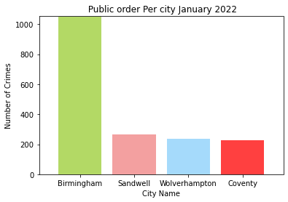
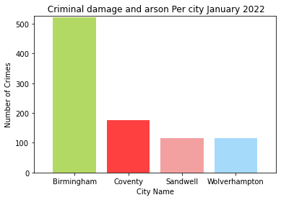
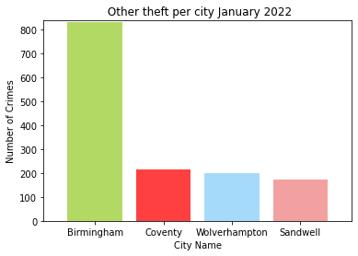
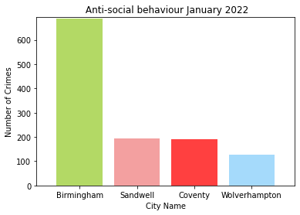
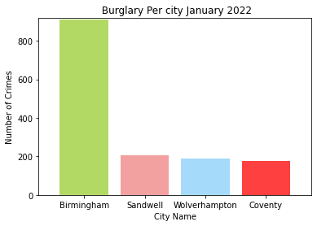
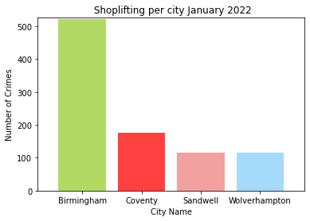
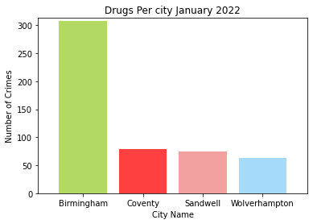
Bar Charts for every type of crime in Birmingham, Coventry, Sandwell and Wolverhampton Jan 2022

Slide 15
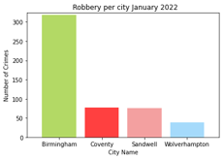
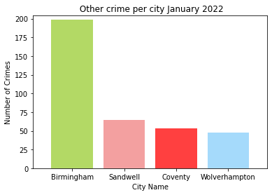
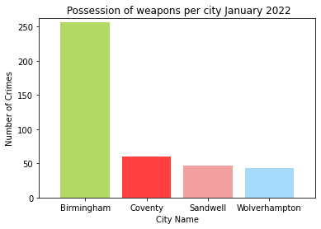
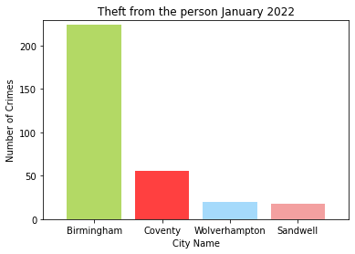
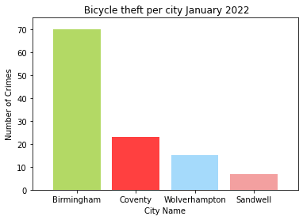

Slide 16
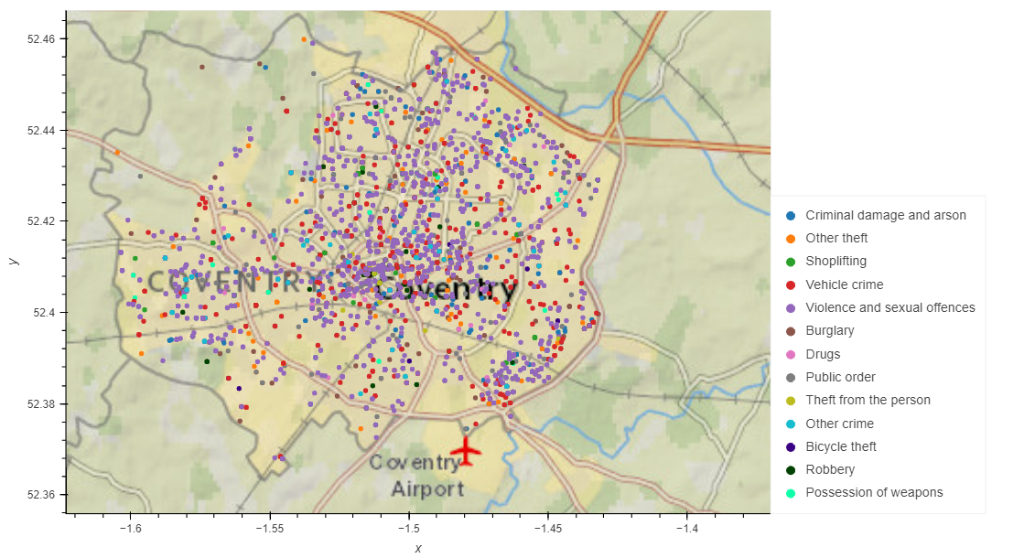
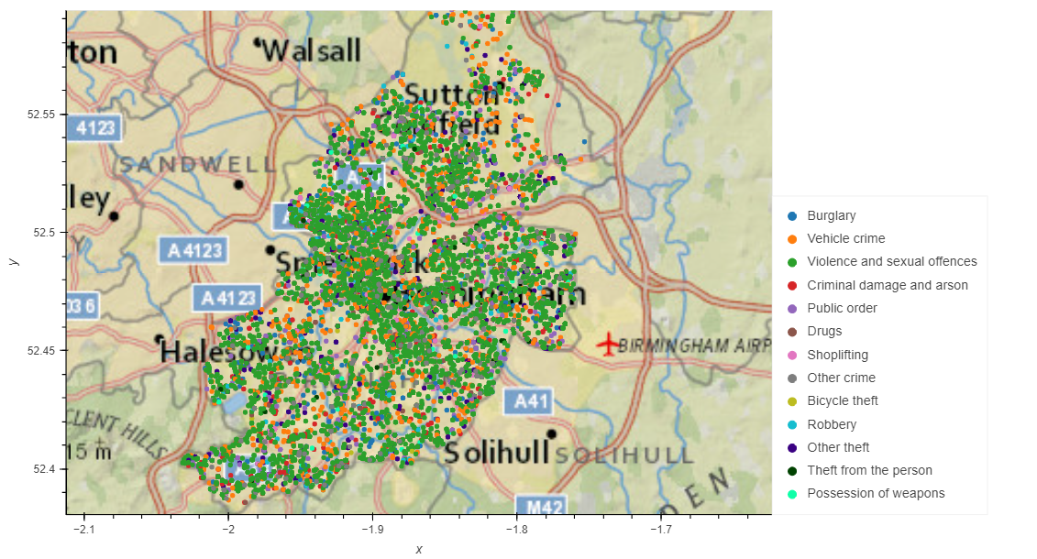
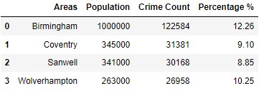
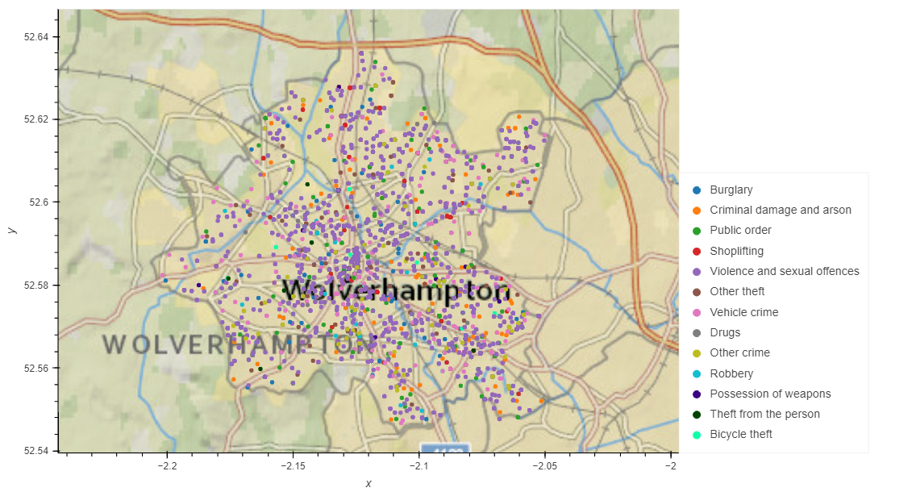
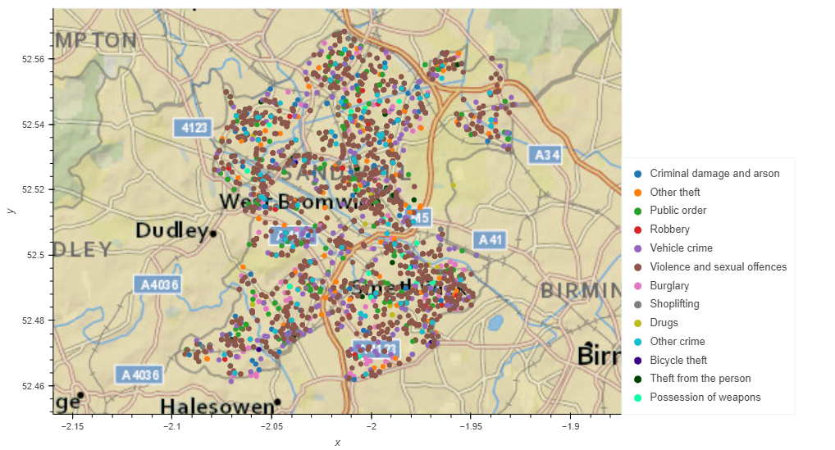
Q3 - How are the crime cases distributed in the 4 areas? Does the population affect the crime rate?
Areas | Population
Birmingham | 1.1 Million
Coventry | 345 Thousand
Sandwell | 341 Thousand
Wolverhampton | 263 Thousand
Source: UK Office for National Statistics. (web).

Slide 17
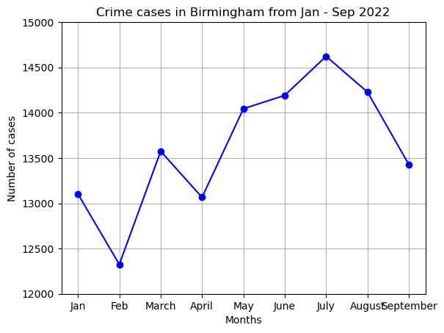
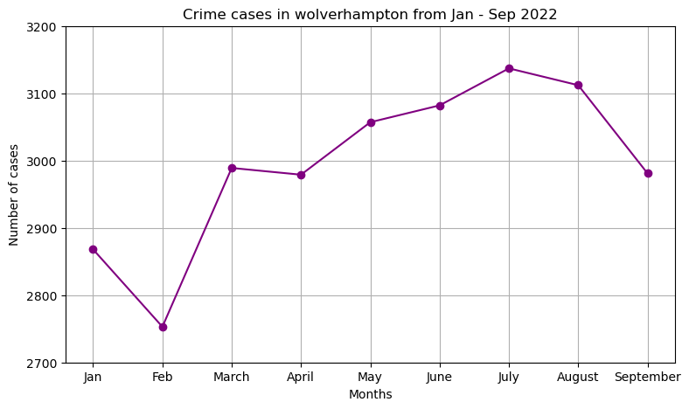
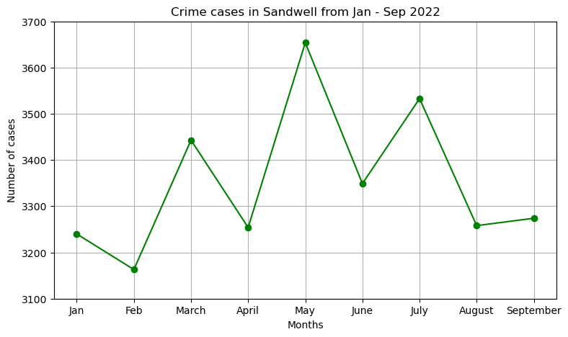
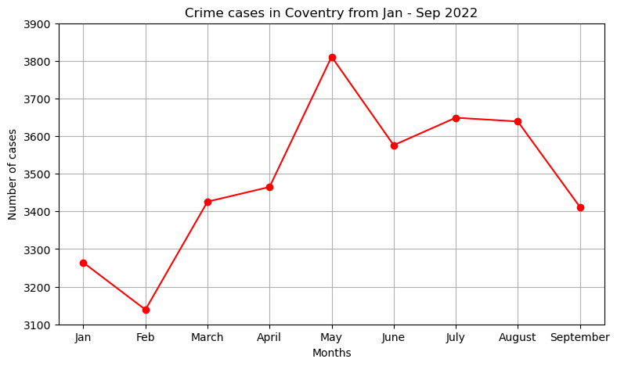
Q4 – Crime rate trend line birmingham, Wolverhampton, coventry and sandwell from jan-sept 2022(peaks and low points))

Slide 18
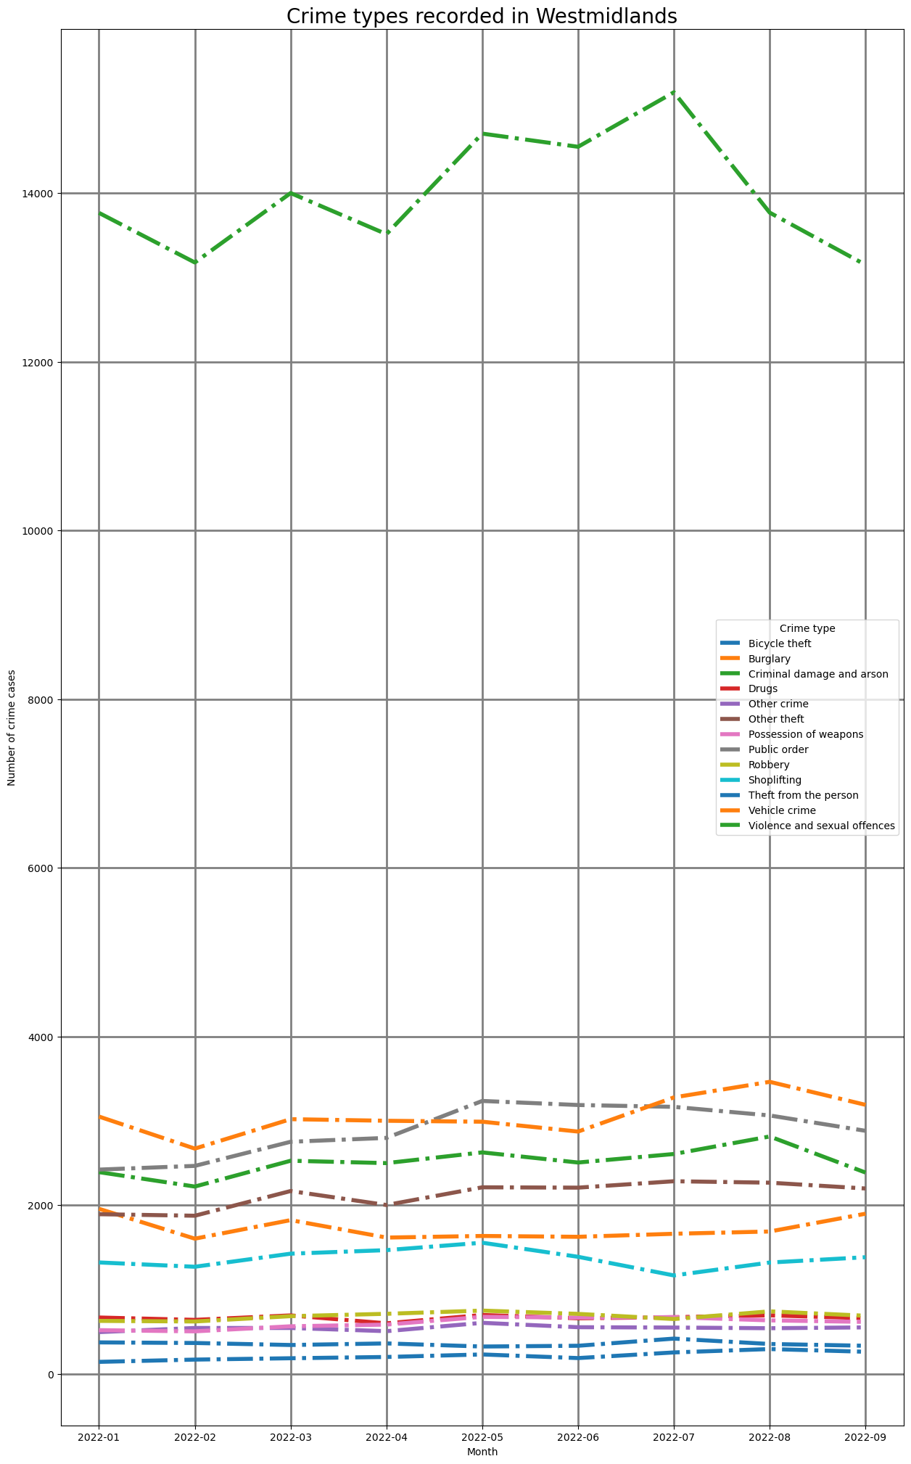

Slide 19
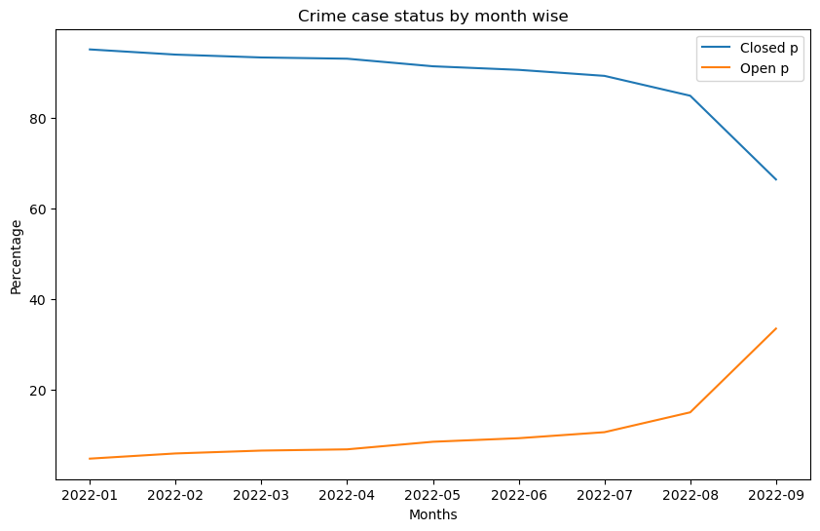
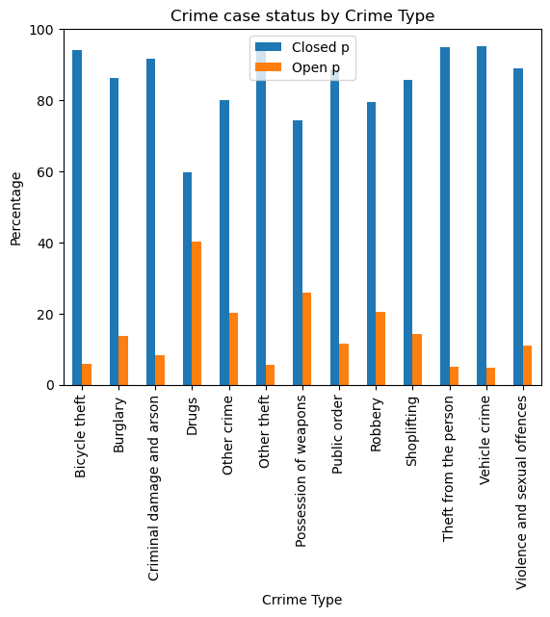
Question 5

Slide 20
Question 6- what are crimes closed outcomes
Investigation Complete - No Suspect Identified
Complete with no Suspect
Unable to prosecute suspect
Formal action is not in the public interest
Further action is not in the public interest
Further investigation is not in the public interest
Complete but couldn’t able to prosecute
Local resolution Offender given a caution
Suspect charged as part of another case
Court result unavailable
Action to be taken by another organisation
Actioned or prosecuted

Slide 21
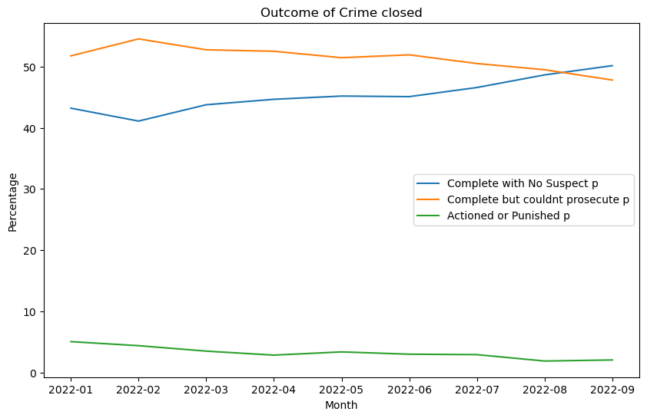
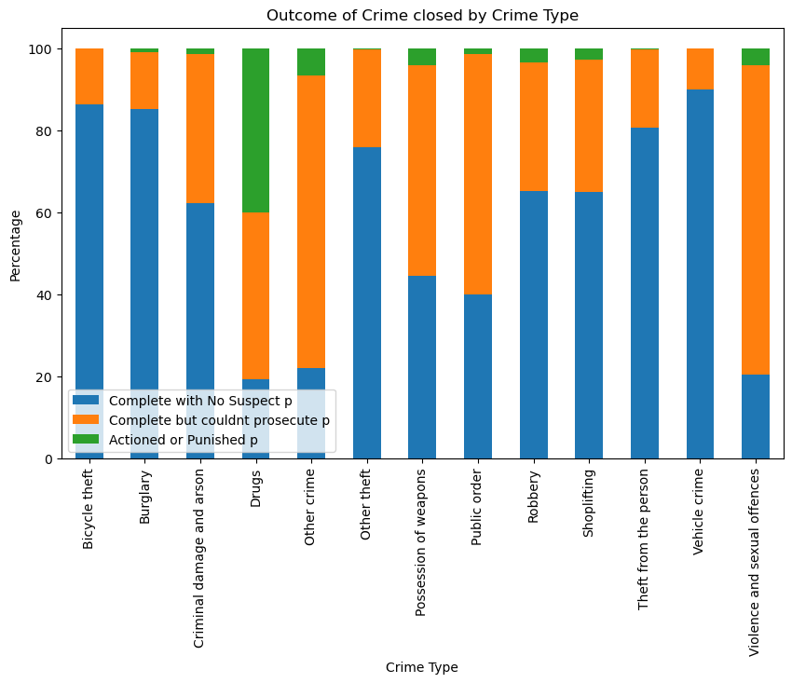
Question 6
Observed number of cases registered are proportioned to population
Police department able to close majority of the cases on paper but the prosecutor get punished are very less
Due to this the suspects could be repeating the crime or more new

Slide 22
Conclusion
Understand the crime types, crime rates and how they are distributed in West Midlands in year 2022
Violence and Sexual offences related cases ranked 1st among crime types
Birmingham area is the focus city to lower crime rate
Population has no significant relationship with people committing crime (not precise calculation)
Ways to lower crime rate
Identify the key people and places driving the violence
Invest in anti-violence workforce development
Commit to continuous improvement based on data, evidence
Improvements
Spend more time to get in-depth analysis
Do more outside reading or researches on relevant topic and usage of python applications
Get more accurate dataset (some small towns data were not included in the data set obtained)

Slide 23
HOW WE GET results
Excel
Matplotlib
Geopify API
To understand the structure of the dataset
Give information on how to approach in different applications in Python
To produce plots to show the dataset
To get a clear picture of number of cases reported
To produce the map distribution
Shows clearly how the crime types are distributed

Slide 24
THANK YOU

